Slide 1
HTML & CSS basics
János Stefán
Nyíregyháza – 2025/02/11

Slide 2
Agenda
01
Utilities
02
HTML5
03
CSS
04
SCSS
05
Responsive web design
06
Practice

Slide 3
UI Developer utilities
Essential tools for User Interface & Front-End development in 2024

Slide 4





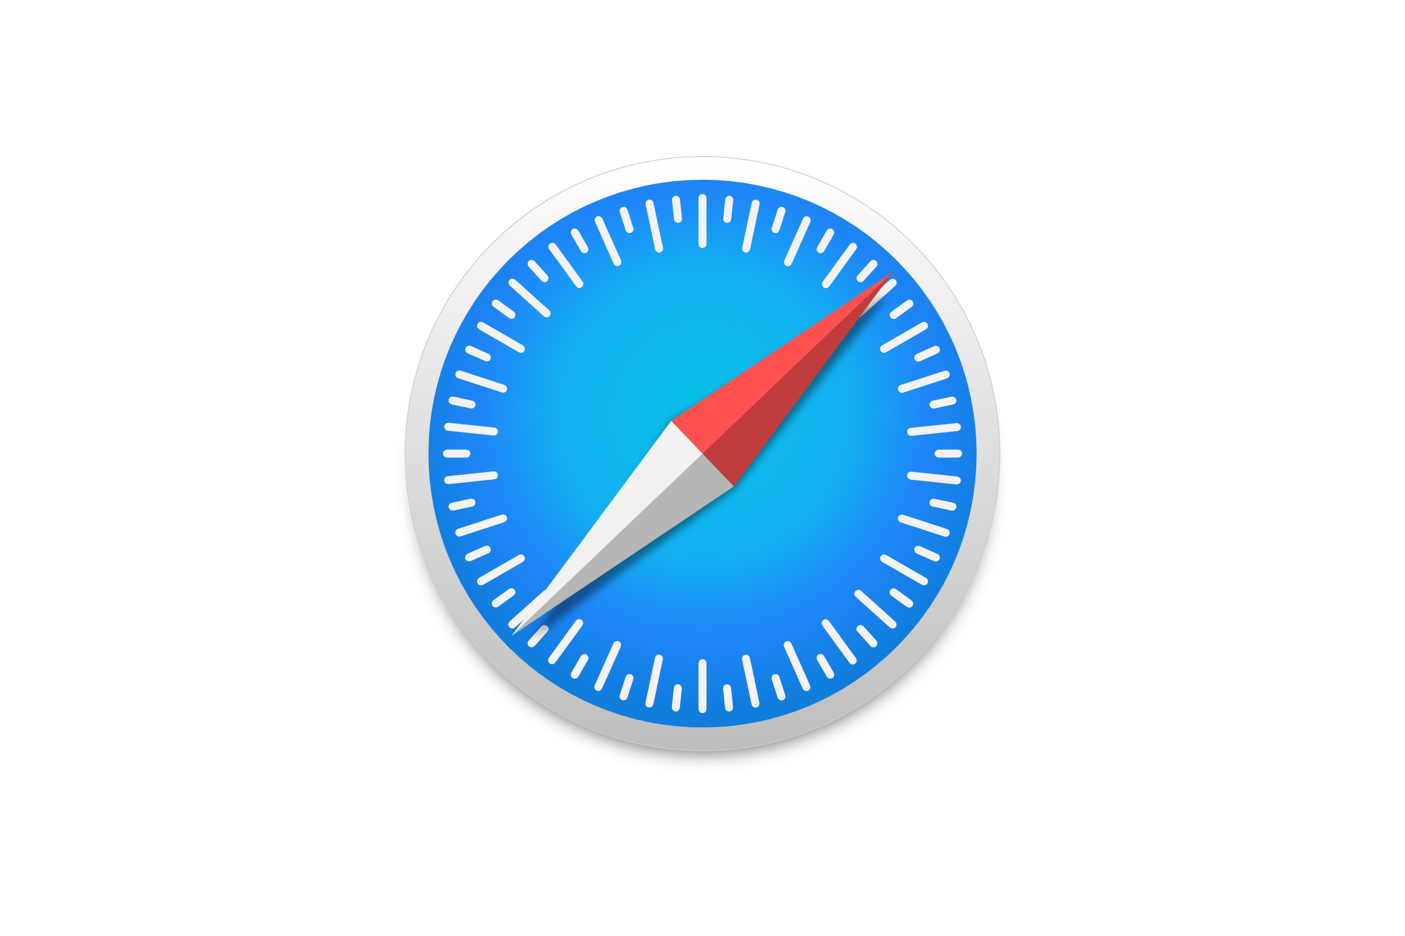



What we’ll need to start?
Essential Tools
IDE: Visual Studio Code / Webstorm supports JavaScript and related technologies
Node.JS open-source, cross-platform JS runtime environment
Node Package Manager comes together with Node.JS as default package manager
Chrome / Firefox / Edge / Safari any kind of preferred up-to-date browser
GitHub account
Abstract visual mindset

Slide 5

HTML5
Hyper Text Markup Language
Basic structure and essentials
Semantics

Slide 6
HTML – Hyper Text Markup Language
<!DOCTYPE html> <html> <head> <title>This is the page title</title> </head> <body> <h1>First heading</h1> <p>My first paragraph.</p> </body> </html>

Slide 7
HTML – Hyper Text Markup Language
Informs the browser which version of HTML you used to write the document
Doctype is a declaration, not a tag
<!DOCTYPE html> <html> <head> <title>This is the page title</title> </head> <body> <h1>First heading</h1> <p>My first paragraph.</p> </body> </html>

Slide 8
HTML – Hyper Text Markup Language
<!DOCTYPE html> <html> <head> <title>This is the page title</title> </head> <body> <h1>First heading</h1> <p>My first paragraph.</p> </body> </html>
Represents the root of an HTML document
All other elements must be descendants of this element

Slide 9
HTML – Hyper Text Markup Language
Provides general information (metadata) about the document, including title and links to definitions of scripts and style sheets
<!DOCTYPE html> <html> <head> <title>This is the page title</title> </head> <body> <h1>First heading</h1> <p>My first paragraph.</p> </body> </html>
Represents the content of an HTML document
There can be only one <body> element in a document

Slide 10
Some common HTML elements
<a>
<span>
<img> <svg>
<i> <em>
<b> <strong>
<p>
<h1>...<h6>
<div>
<ul> <ol> <li>
<form> <input> <select> <textarea>
<table> <tr> <td>
<header>
<main>
<footer>
<section>
<article>
<nav>
<address>
<figure> <figcaption>
<aside>
<audio> <video>
Other goodies:
Canvas
Editable HTML5 content
Web USB API
Augmented Reality
https://developer.mozilla.org/en-US/docs/Web/HTML/Element

Slide 11

CSS
Cascading Style Sheets basics
Selectors
Box model
Positioning
Media Queries

Slide 12
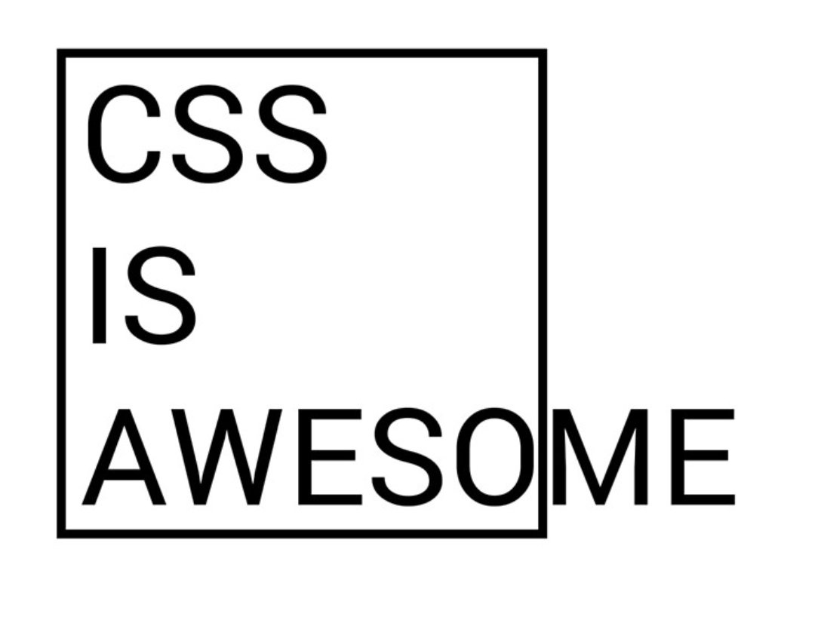
What is CSS?
CSS stands for Cascading Style Sheets
CSS is a language that describes the style of an HTML document
CSS describes how HTML elements should be displayed
CSS is used to define styles for your web pages, including the design, layout and variations in display for different devices and screen sizes

Slide 13
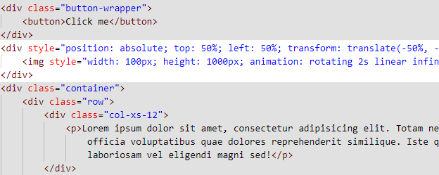

Inline styles
What is CSS?

Slide 14
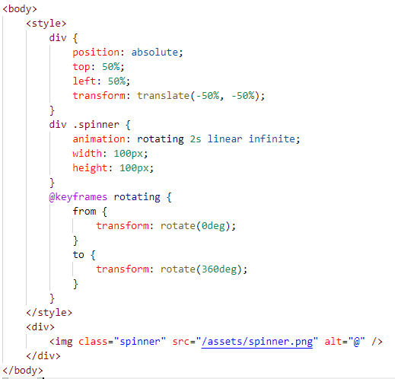
Style tags
What is CSS?

Slide 15
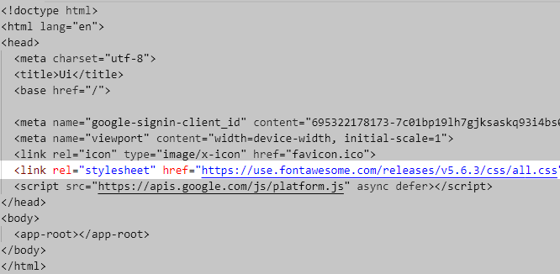

External stylesheet
What is CSS?

Slide 16
Selectors
CSS selectors are used to „find” (or select) the elements you want to apply the style to
Simple
Combinator
By Relationship
Child
Pseudo-class
By state
:checked
ID
Pseudo-elements
Attribute
className
name
Sibling
:active
Element part
::first-letter
::after
By attribute / value
[href*=”example”]
[data-info]
https://developer.mozilla.org/en-US/docs/Learn/CSS/Building_blocks/Selectors

Slide 17
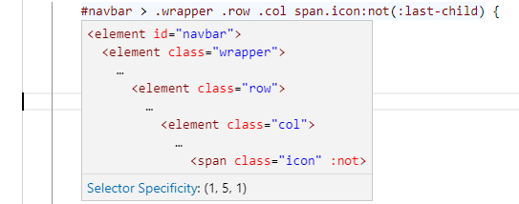
CSS Specifity
A vector that determines which CSS property values are the most relevant to an element and therefore will be applied
(_, _, _, _)
0 by definition*
IDs
classes & pseudo classes
elements & pseudo elements
*Elements with inline styles will be the strongest, so their specifity vector will be (1, 0, 0, 0)
Unless: !important

Slide 18
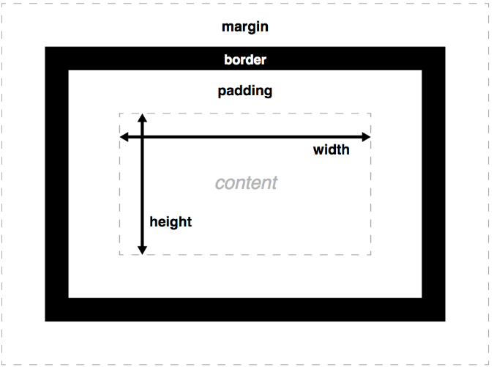
Understanding box model
Box Model
The box model is the specification that defines how a box, and its attributes relate to each other
Consists of:
margin
border
padding
size: width & height
Default behavior (content-box): padding & border are added to content’s width/height
https://developer.mozilla.org/en-US/docs/Learn/CSS/Building_blocks/The_box_model

Slide 19
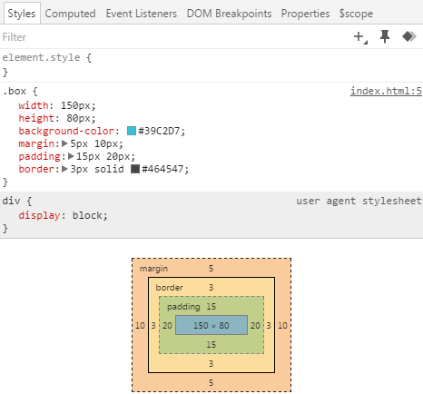
Box model in action
Box model
.box

Slide 20
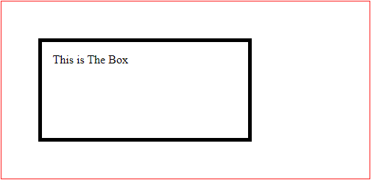
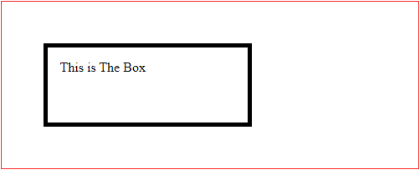
Box model in action
Box Model
Browser default
.container {
border: solid 1px #F22;
margin: 0 auto;
width: 500px;
}
#box {
border: solid 5px #000;
height: 100px;
margin: 50px;
padding: 15px;
width: 50%;
}
500px / 2 + 2*15px
140px 2*50px + 2*1px ------------- 242px
+ 2*5px
= 140px
100px + 2*15px
+ 2*5px = 290px
box-sizing: "border-box"
500px * 50% = 250px
100px 2*50px + 2*1px ------------- 202px
<div class="container">
<div id="box">This is The Box</div>
</div>
100px

Slide 21
What methods do we have?
Positioning
margin
float
position
flexbox
grid

Slide 22
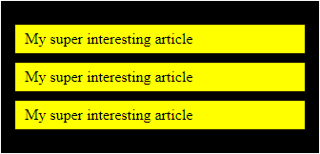
Margin
Positioning
.blog-list {
background-color: black;
padding: 15px;
}
.blog-post {
background-color: yellow;
padding: 6px 10px;
margin: 10px 0;
width: 100%;
}
<section class="blog-list">
<article class="blog-post">
My super interesting article
</article>
<article class="blog-post">
My super interesting article
</article>
<article class="blog-post">
My super interesting article
</article>
</section>
Move the element away from its position
Margin collision
Not included in the click region
Center horizontally with margin:
Set width attribute
Set left and right margin to auto
Align right / left
Set width attribute
Set only margin-left or margin-right
Negative margins
The definite guide to using negative margins
Methods to center elements

Slide 23
Float
Positioning
Document flow:
regular way how the elements will be displayed. It reflects the order of the elements written in the HTML file
Floating:
Moving an element horizontally to the furthermost position
Elements will use only the space the need e.g: block level elements will NOT take up the whole horizontal space
The element will NOT be taken out of the normal flow
The parent containers will NOT adapt to the floated elements’ height
Thus needs to be cleared
float: left | right | none;
clear: left | right | both | none;

Slide 24
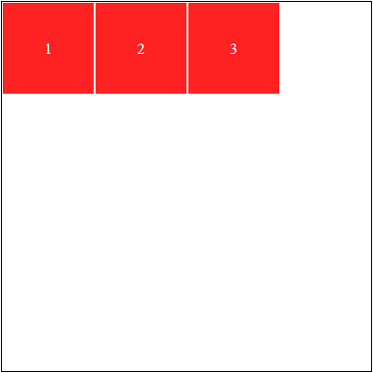
Float
Positioning
.container {
border: solid 1px #000;
height: 400px;
width: 400px;
}
.item {
background-color: #F22;
border: solid 1px #FFF;
color: #FFF;
float: left;
height: 100px;
line-height: 100px;
text-align: center;
width: 100px;
}
<div class="container">
<div class="item">1</div>
<div class="item">2</div>
<div class="item">3</div>
</div>

Slide 25
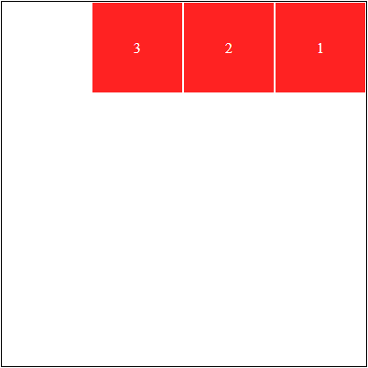
Float - right
Positioning
.container {
...
}
.item {
float: right;
...
}
<div class="container">
<div class="item">1</div>
<div class="item">2</div>
<div class="item">3</div>
</div>

Slide 26
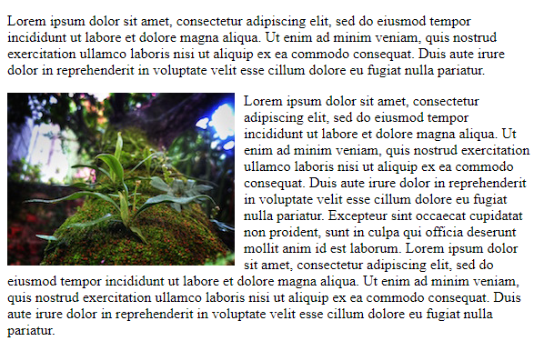
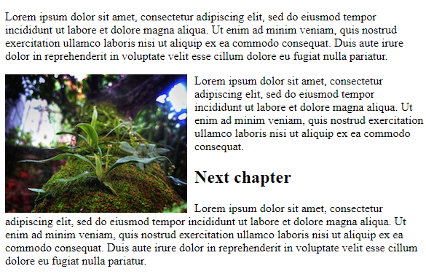
Float - clearing
Positioning

Slide 27

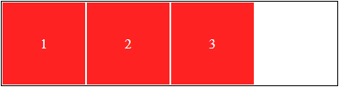
Float – clearing – clearfix
Positioning
.container {
...
height: 400px;
}
.item {
...
}
.clear-fix::after {
clear: both;
content: "";
display: block;
}

Slide 28
Position
Positioning
Natural: static
Position the element to its natural place, in the normal document flow
Not affected by top, bottom, left, right properties
Offset: relative | absolute | fixed | sticky
Creates positioning context
If no offset parent is defined then the topmost tag will act as the offset parent
Types
Relative: relative to its normal position
Absolute: relative positioned to the nearest not static ancestor – body if no other
Fixed: relative positioned to the browser window – scroll does not affect its placement
Sticky: combined static and fixed
position: static
relative
absolute
fixed
sticky
Connected attributes:
bottom
left
right
top

Slide 29

Position – gallery
Positioning
.gallery-item {
display: block;
margin: 0;
overflow: hidden;
padding-top: 56.25%;
position: relative;
width: 100%;
}
.gallery-item img {
display: block;
height: auto;
left: 0;
position: absolute;
top: 0;
width: 100%;
z-index: 1;
}
.gallery-item .description {
background: rgba(102,102,102,.7);
bottom: 0;
color: #FFF;
font-size: .75em;
left: 0;
line-height: 2;
padding: 0 10px;
position: absolute;
right: 0;
text-align: center;
z-index: 2;
}
<figure class="gallery-item">
<img src="https://placeimg.com/1920/1080/tech" />
<figcaption class="description">Tech</figcaption>
</figure>

Slide 30
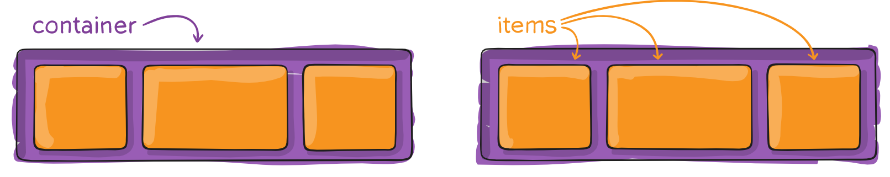
Flexbox
Positioning
Container properties:
flex-direction flex-wrap
flex-flow
justify-content
align-items
align-content
gap, row-gap, column-gap
Item properties
order
flex-grow
flex-shrink
flex-basis
flex
align-self
The Flexbox Layout module aims at providing a more efficient way to layout, align and distribute space among items in a container, even when their size is unknown and/or dynamic (thus the word "flex")
Flexbox layout is most appropriate to the components of an application, and small-scale layouts, while the Grid layout is intended for larger scale layouts.
https://css-tricks.com/snippets/css/a-guide-to-flexbox/

Slide 31
Browsers default styles
Reset / normalize
Problem:
Not all browsers apply the same default rules – they may be similar, but not exact
It can be difficult to provide the same designs in each browser if the basic rules are different
Every tag has its’ own margin/padding/font-size or display mode
Could cause a lot of effort to simply override default values each time
Solutions:
Reset to a specific value for each tag (nullify) https://meyerweb.com/eric/tools/css/reset/index.html
Normalize: set a standard value across browsers https://necolas.github.io/normalize.css/
CSS reset style sheet should always go first
http://web.simmons.edu/~grovesd/comm244/notes/week4/css-reset

Slide 32

SCSS
CSS preprocessors
Sass and Less

Slide 33
CSS preprocessors: Sass & Less
A program that lets you generate CSS from the preprocessor’s own unique syntax
Add some features that don’t exists in pure CSS (e.g. mixin, nesting or inheritance selector)
Makes the CSS structure more readable and easier to maintain
Needs a compiler to turn SCSS code into pure CSS
Additional features:
minify
join files into one
splitting into common & page-specific css

Slide 34
Features – variables
CSS preprocessors
SASS
$pimary-color: #333;
body {
color: $primary-color;
}
CSS
:root {
--primary-color: #333;
} body {
color: var(--primary-color);
}

Slide 35
Features – nesting
CSS preprocessors
SASS
ul {
…
li {
…
a {
…
&:hover { … }
}
}
}
CSS
ul { … } ul li { … } ul li a { … } ul li a:hover { … }

Slide 36
Features – mixins
CSS preprocessors
SASS
@mixin border-radius($radius) {
-webkit-border-radius: $radius;
-moz-border-radius: $radius;
-ms-border-radius: $radius;
border-radius: $radius;
}
.box {
@include border-radius(10px);
}
CSS
.box {
-webkit-border-radius: 10px;
-moz-border-radius: 10px;
-ms-border-radius: 10px;
border-radius: 10px;
}
https://caniuse.com/?search=border-radius

Slide 37
Features – mixins
CSS preprocessors
SASS
@mixin hover {
&:not([disabled]):hover {
@content;
}
}
.button {
border: 1px solid black;
@include hover {
border-width: 2px;
}
}
CSS
.button {
border: 1px solid black;
}
.button:not([disabled]):hover {
border-width: 2px;
}

Slide 38
Features – inheritance & extension
CSS preprocessors
Placeholder class
Extend
%toast {
border: 1px solid #333;
padding: 5px;
background-color: green;
}
.normal {
@extend %toast;
}
.error {
@extend %toast;
background-color: red;
}

Slide 39

Responsive web design
Media queries
Device support
Breakpoints

Slide 40
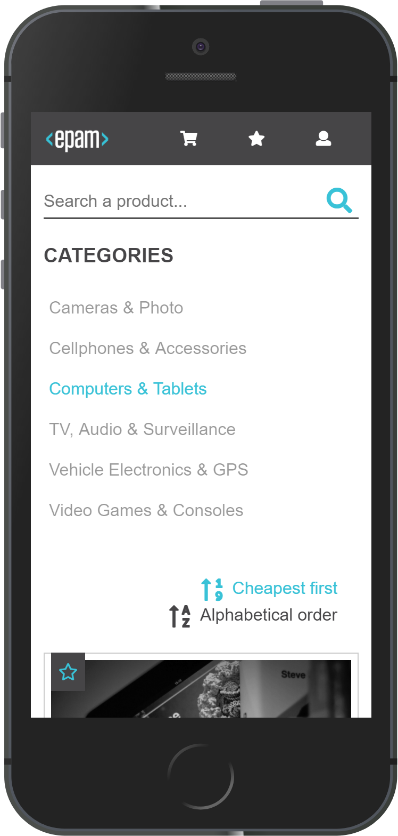


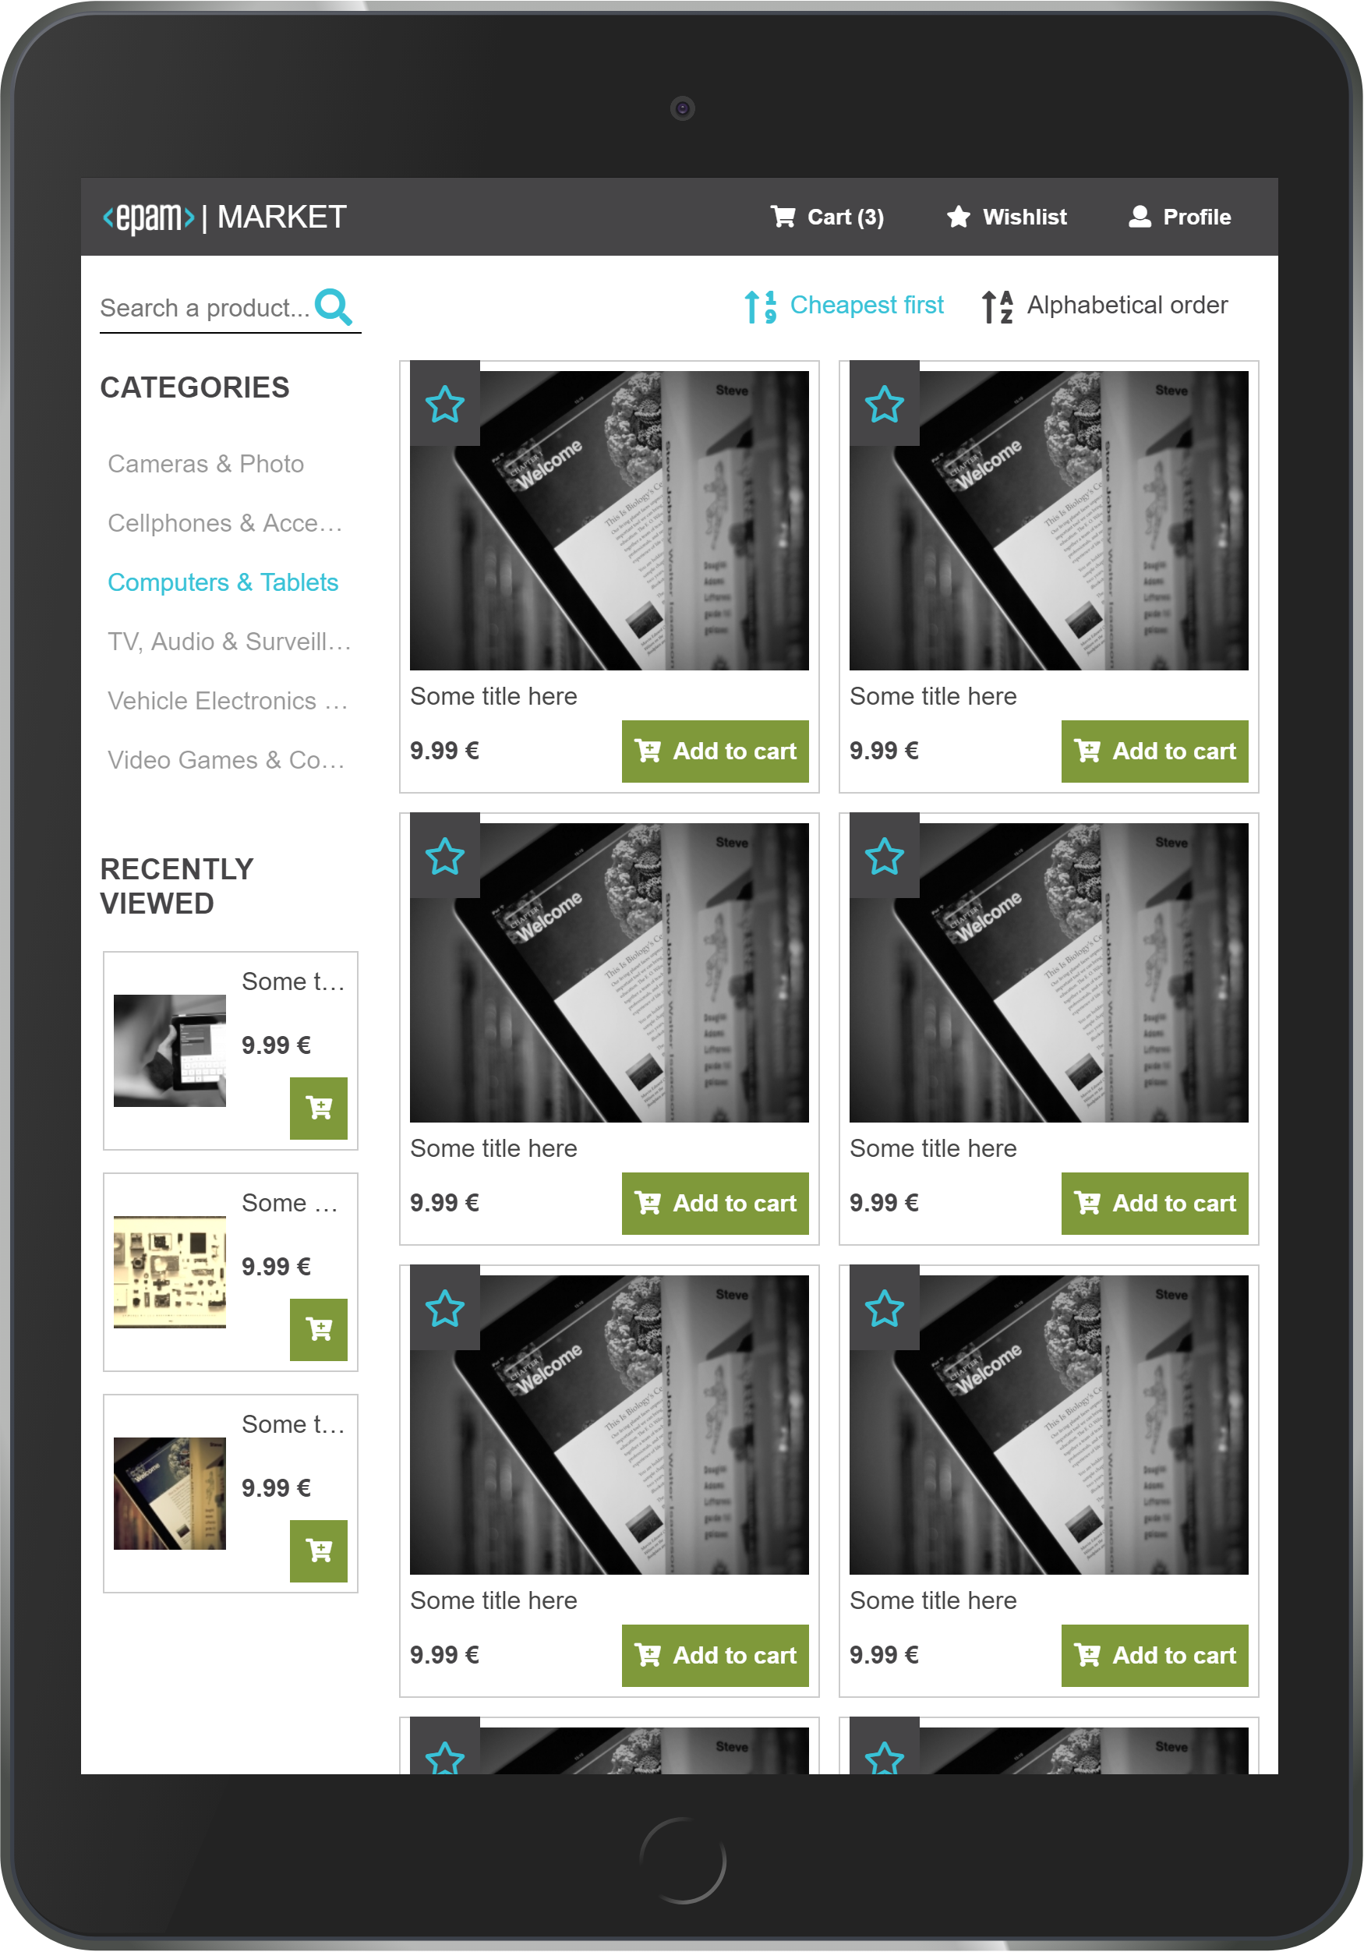

What is RWD?
Responsive web design
An approach to make web pages render well on a variety of devices and window or screen sizes within a defined range to ensure usability.
Adapts the web-page layout to the view environment by using:
Fluid proportion-based grids prefers using relative units (e.g. em or percentage) instead of absolute ones (pixels or points)
Flexible images also uses relative sizes combined with device-dependent sources (image src-set) or vector graphics (svg)
CSS3 media queries define rules by device configuration (e.g. screen size or orientation)

Slide 41
What is a media query?
Responsive web design
<meta name="HandheldFriendly" content="True">
<meta name="MobileOptimized" content="375">
<meta name="mobile-web-app-capable" content="yes">
<meta name="viewport"
content="width=device-width,initial-scale=1.0">
@media (max-width: 640px) and (orientation: portrait) {
.list-item {
width: 50%;
}
}
@media screen and (max-width: 480px) {
.list-item {
width: 100%;
}
}
Logical operators: and, or, not, only
Media features:
width, min-width, max-width
height, min-height, max-height
orientation, aspect-ratio
resolution, min-resolution, max-resolution
CSS3 features allowing content rendering to adapt to different conditions.
A media query consists of a media type and at least one expression that limits the stylesheets’ scope by using media features, such as width, height and color
Main approaches:
Mobile-first
The page is designed mainly for handheld devices
Upsize the layout for bigger screens
Desktop-first
The primary view is for large screen devices
Layout downsizing

Slide 42
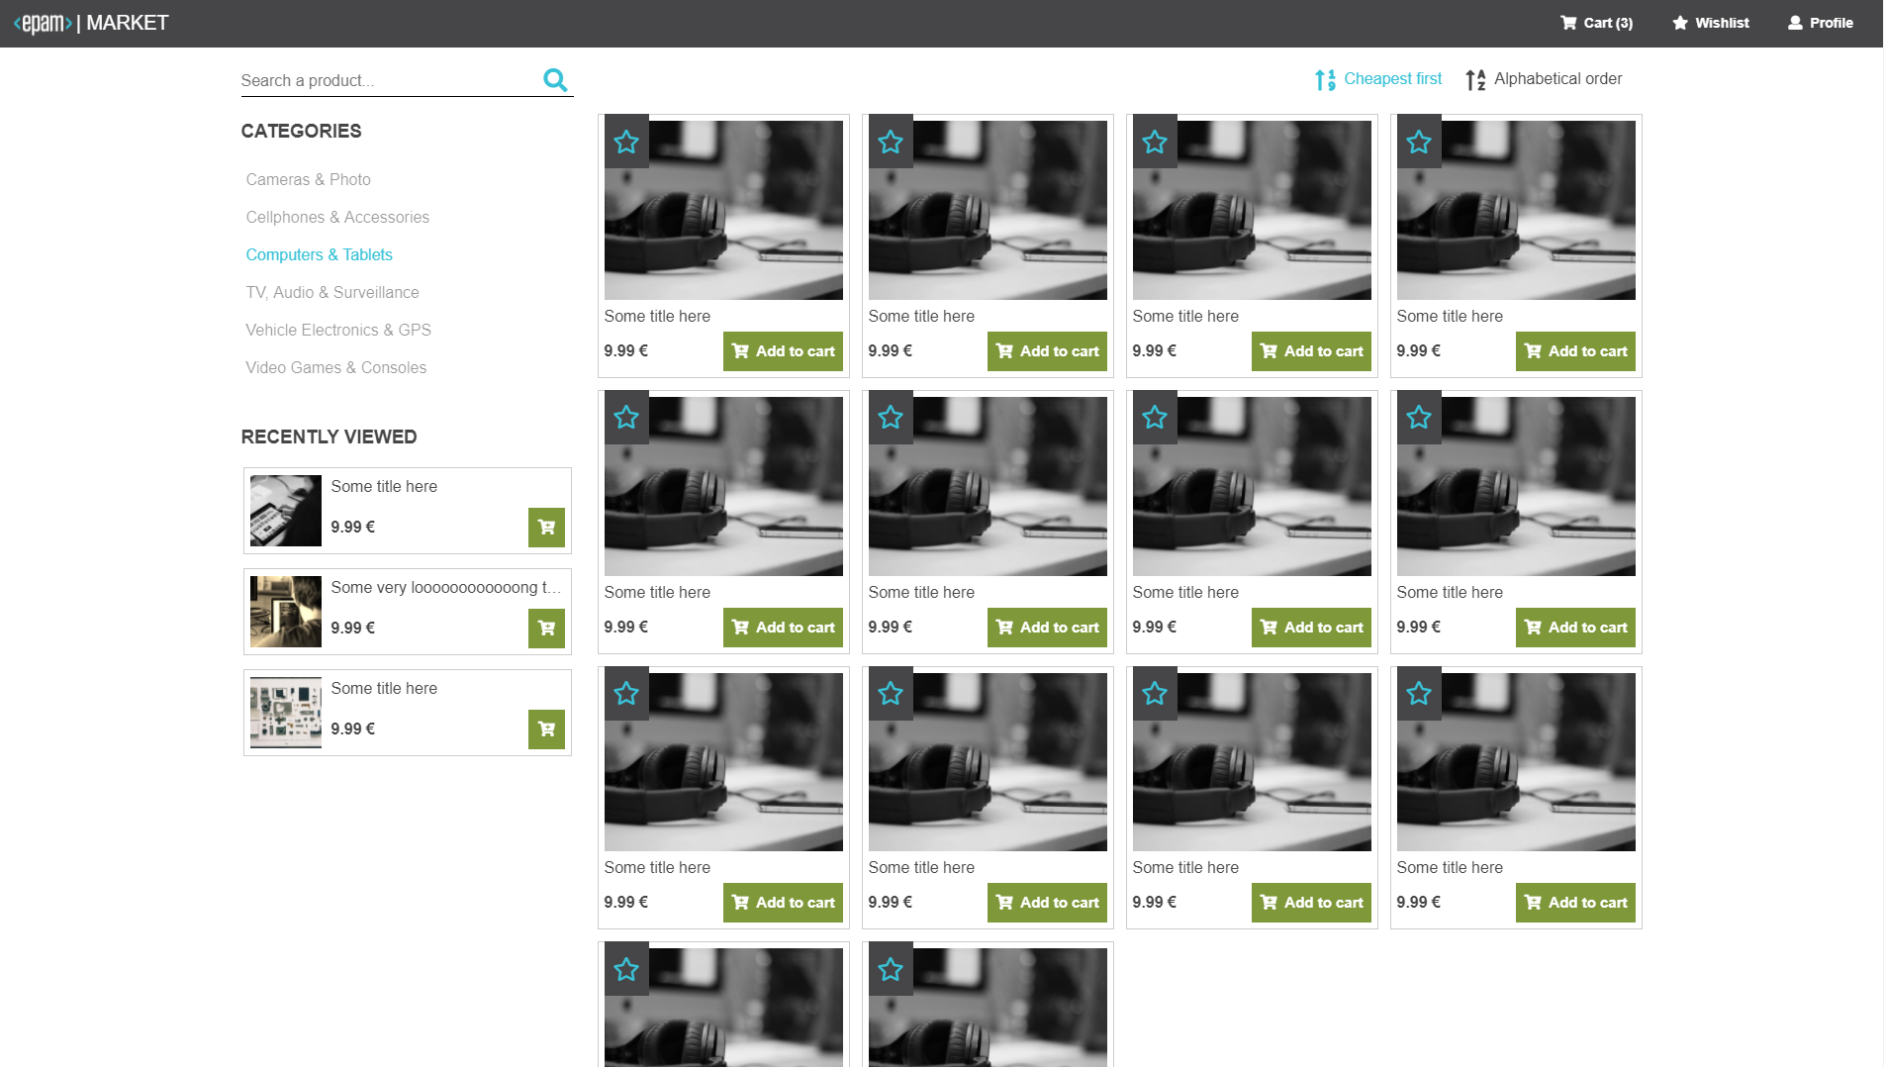
Breakpoints
Responsive web design
We can add a breakpoint where certain parts of the design will behave differently on each side of the breakpoint.
„Start with the small screen first, then expand until it looks like shit. Time for a breakpoint!”
Stephen Hay
Conditional loading contents: load the main things first
Mobile first / desktop first dilemma: which would fit better?

Slide 43
Thank you!
For more information, contact
Janos Stefan
Junior Software Engineer
janos_stefan@epam.com
EPAM Debrecen
Tüzér street 4.
HU-4028 Debrecen

